Slide 1
House Price Prediction
Weijia Zhou 10429862

Slide 2

Photo

Slide 3
The dataset
Source | Columns | Data Type | Rows
Kaggle | 81 | Float64(3) int64(35)object(43) | 1600
The Models
SVM(SVR) | RondomForest (RFRegressor) | DecisionTree (DTRegressor) | Lasso | GraidentboostingRegressor | LinearRegressor | Neural Network

Slide 4
Methods
Dataset
Method1
PCA
NN

Slide 5
Method 1
1. Searching on the Internet(intuition)
2. Using Heatmap(Logical)
Choose top 10 or 15 features
Problem1: Heatmap can only deal with non-categorical values
Solution1: Using label Encoder
Problem2: Heatmap can only show the relationship using colors, how to choose?
Solution2: Using correlation matrix
Problem3: How to deal with the relationship between each features?
Solution3: set a threshold
3.Feature selection
'SalePrice','OverallQual','GrLivArea','CarPerArea','basementAnd1stFloorArea','FullBath','YearBuilt','TotRmsAbvGrd','YearRemodAdd’
4.Feature engineering
GarageArea, GarageCars->CarPerArea, 1stFlrSF, TotalBsmtSF->basementAnd1stFloorArea, etc
Using scatter plot to see the distribution
5. Fitting Model, and predict
6. Result

Slide 6
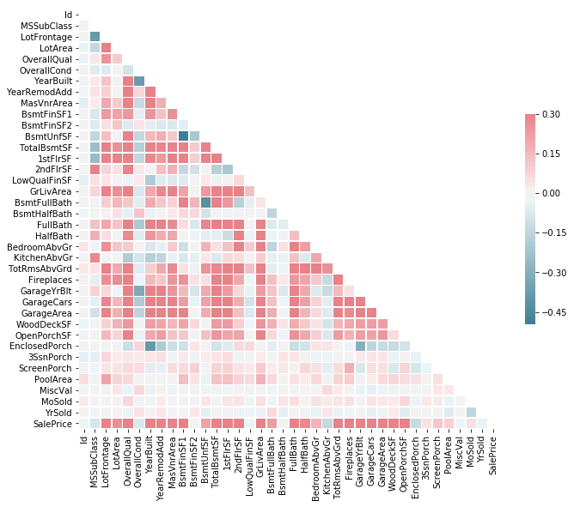
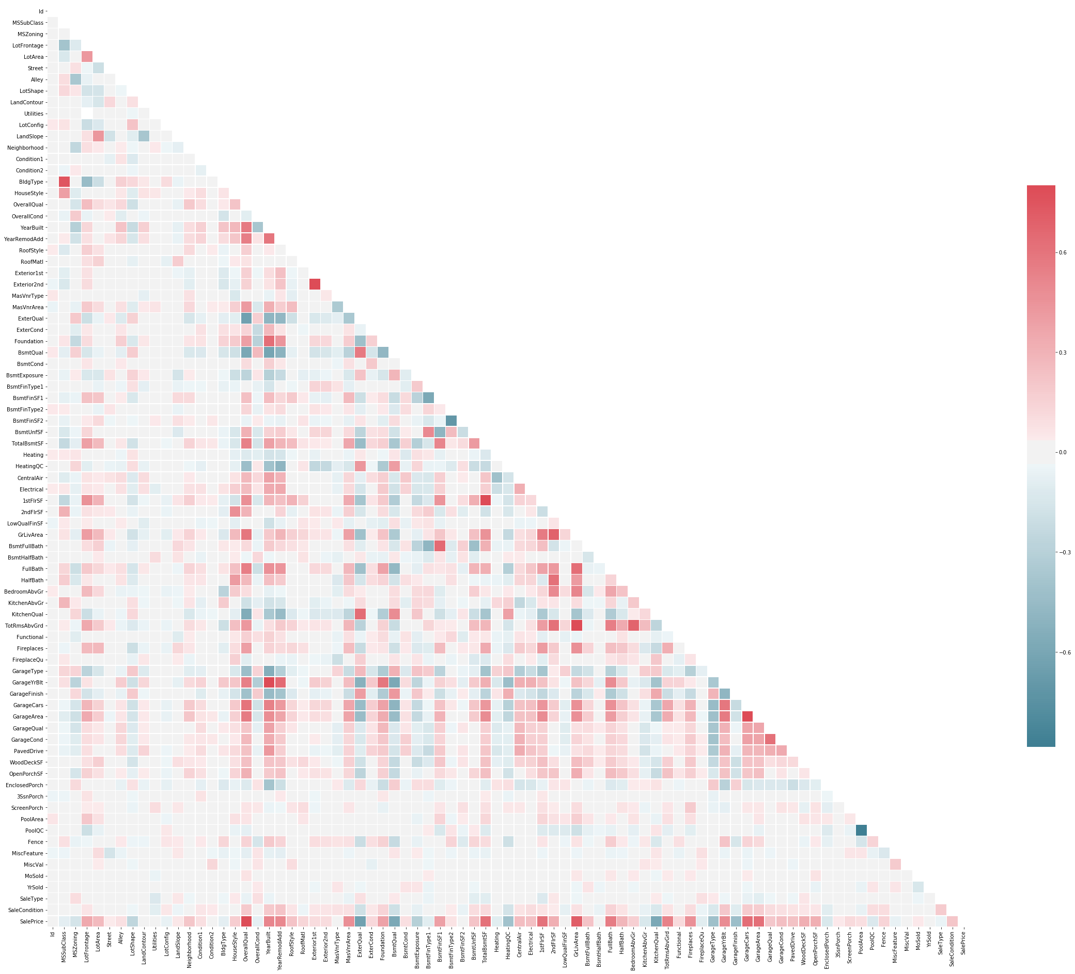
Heatmap

Slide 7
Method 1
1. Searching on the Internet(intuition)
2. Using Heatmap(Logical)
Choose top 10 or 15 features
Problem1: Heatmap can only deal with non-categorical values
Solution1: Using label Encoder
Problem2: Heatmap can only show the relationship using colors, how to choose?
Solution2: Using correlation matrix
Problem3: How to deal with the relationship between each features?
Solution3: set a threshold
3.Feature selection
'SalePrice','OverallQual','GrLivArea','CarPerArea','basementAnd1stFloorArea','FullBath','YearBuilt','TotRmsAbvGrd','YearRemodAdd’
4.Feature engineering
GarageArea, GarageCars->CarPerArea, 1stFlrSF, TotalBsmtSF->basementAnd1stFloorArea, etc
Using scatter plot to see the distribution
5. Fitting Model, and predict
6. Result

Slide 8
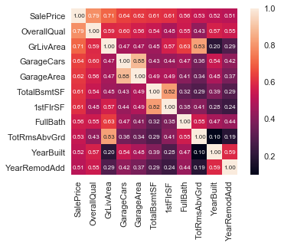
Correlation Matrix

Slide 9
Method 1
1. Searching on the Internet(intuition)
2. Using Heatmap(Logical)
Choose top 10 or 15 features
Problem1: Heatmap can only deal with non-categorical values
Solution1: Using label Encoder
Problem2: Heatmap can only show the relationship using colors, how to choose?
Solution2: Using correlation matrix
Problem3: How to deal with the relationship between each features?
Solution3: set a threshold
3.Feature selection
'SalePrice','OverallQual','GrLivArea','CarPerArea','basementAnd1stFloorArea','FullBath','YearBuilt','TotRmsAbvGrd','YearRemodAdd’
4.Feature engineering
GarageArea, GarageCars->CarPerArea, 1stFlrSF, TotalBsmtSF->basementAnd1stFloorArea, etc
Using scatter plot to see the distribution
5. Fitting Model, and predict
6. Result

Slide 10
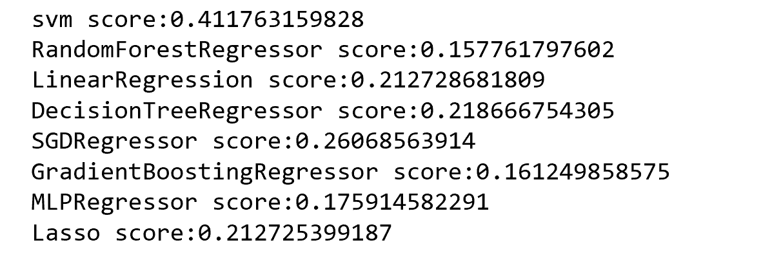
Result

Slide 11
Method2——PCA
Why PCA?
1. Reduce the dimension of dataset
2. Delete the relationship between each features
3. Show most useful and important features
Problem: Categorical values will influence the result of PCA
Solution: Delete the categorical values
Finally, Fit model and predict

Slide 12
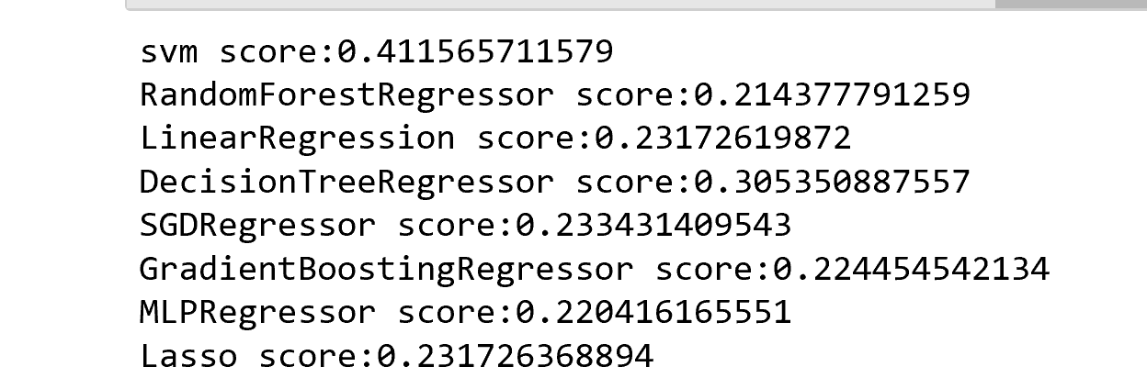
Result

Slide 13
Method3——NN
Keras, tensorflow as backend
My Neural Network
Layer: 16(1 input layer with 77 input, 14 hidden layer, 1 output layer)
Fully connected
Activation: relu (sigmoid, tanh,etc)
Loss: mean_squared_error(mse)

Slide 14
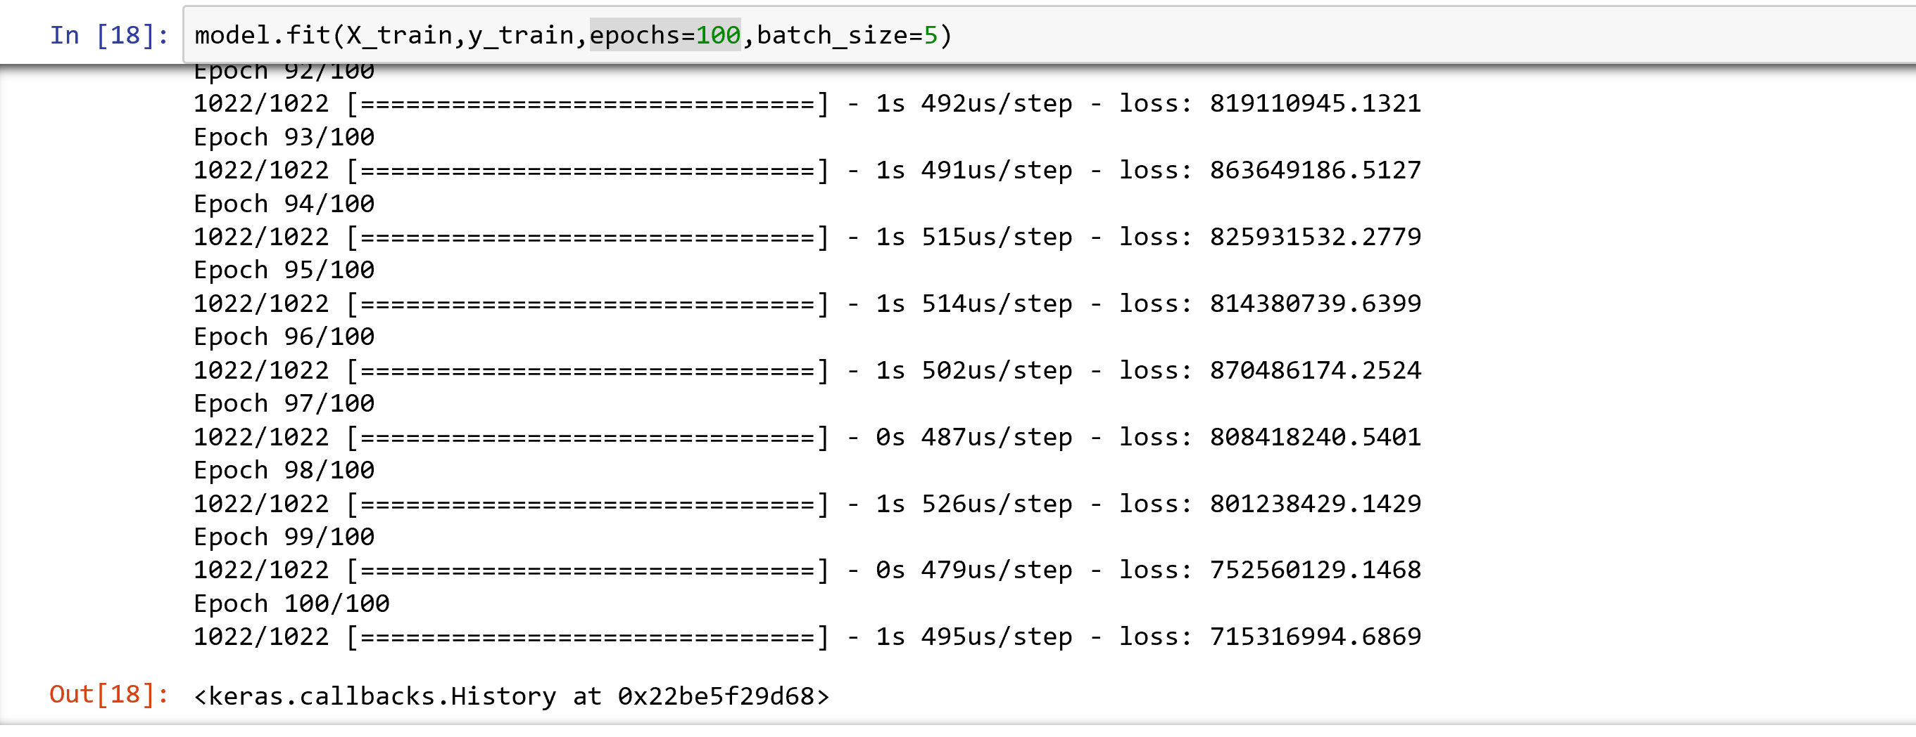
Epochs =100, batch_size =5

Slide 15
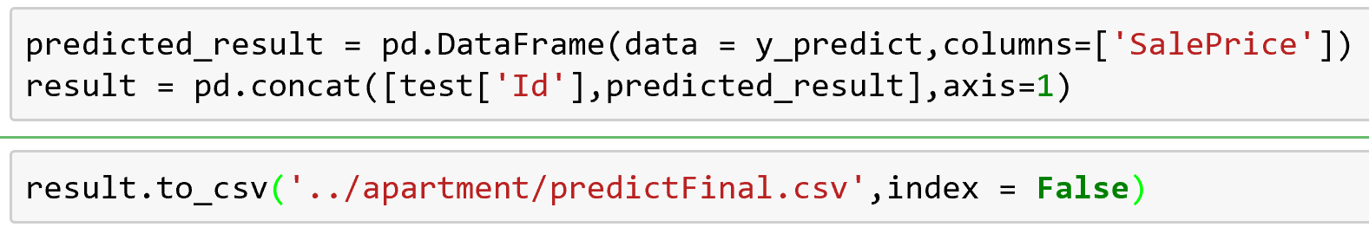
Save Result
Id | SalePrice

Slide 16
Result vs Result in Kaggle
Method | Score
Method1 | 0.15019
PCA | 0.14899
NN | 0.13725
So I choose NN to predict final price, and get a rank: 1800/5300

Slide 17
In the Future
For Feature Engineering – trying different combinations
For PCA- dealing with categorical values
For NN- not using fully connected, try different parameters, Using k fold validation

Slide 18
What I learn from the project?
Learn to deal with your dataset
Use several models with different parameters and compare them
Finishing is not the end, use enough time to improve your project

Slide 19
Thank You!

